Slide 1
Cloud Computing - Storage

Slide 2

What is Windows Azure

Slide 4

VM
VM
VM
VM

Slide 5
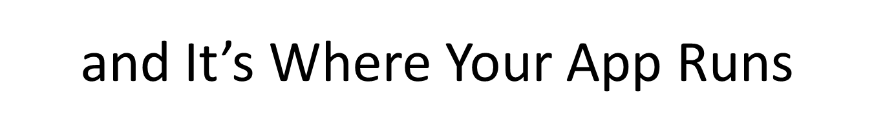
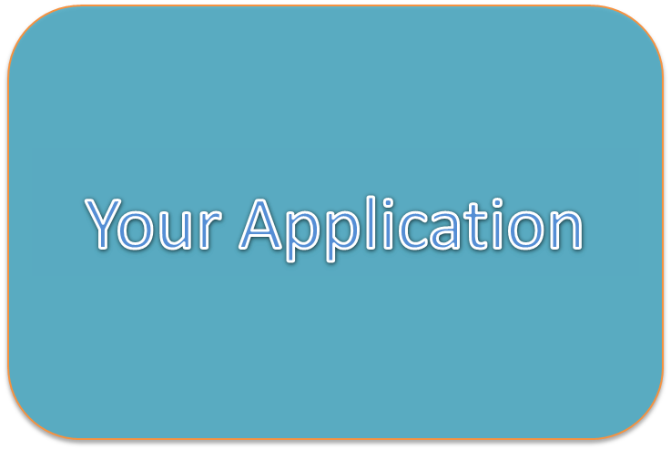

Slide 6
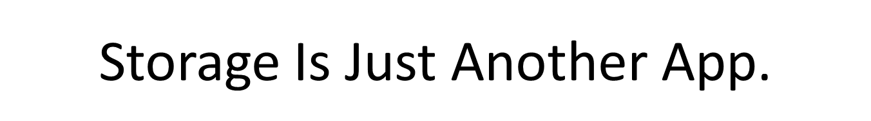
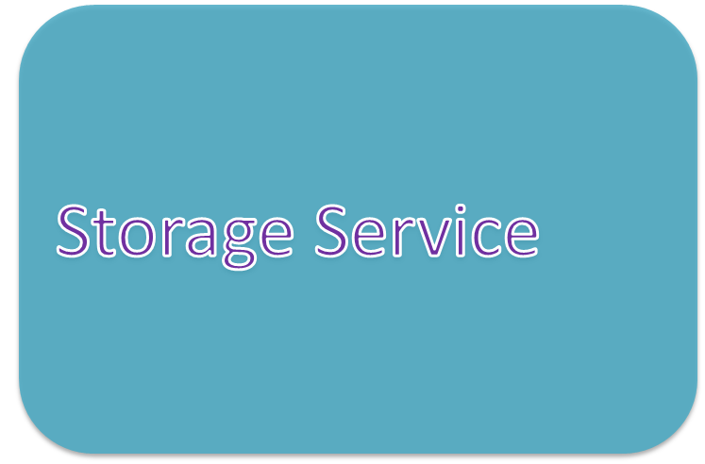

Slide 7
Storage: THE Primary Requirement
One of the main things we need in any computing environment is the ability to interact with some form of data storage – airline reservations, bank accounts, scheduled pizza deliveries

Slide 8
Demo
Notes:
Demo blob service from exercise 2

Slide 9
Scalability: The Primary Design Goal
We moved to the cloud in order to scale. If we didn’t care about scaling, we wouldn’t have gone to the cloud.
Our cloud application’s data handling has to scale well. If it doesn’t, then the cloud’s computational scalability gets bottlenecked into uselessness.

Slide 10
Storage Kingdom 1: Non-Relational
Common storage structures include blobs, tables, and queues
Generally don’t enforce data integrity
As a result, they tend to scale very well
Whatever integrity the program requires is the responsibility of the program developer

Slide 11
Storage Kingdom 2: Relational
These are the classic table-based databases such as Oracle and Microsoft SQL Server
They provide data integrity services, such as not allowing a customer to be deleted from the customer table as long as an order in the order table references that customer
Support complex queries involving joins over multiple tables
Harder to scale well, particularly to multiple machines
Often contain legacy data from apps that need to move to cloud

Slide 12
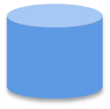
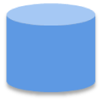
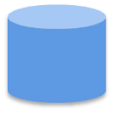




Durable Storage
Three replicas of everything
REST (Representational State Transfer) API
Blobs
Tables
Queues
…

Slide 13
Non-relational Storage: Blobs
BLOB = Binary Large Object
Storage of binary data in a bucket which is opaque to the storage service
Often contains metadata (label on the bucket) that allows one blob to be distinguished from another
Example of content: videos, songs, pictures, newspaper articles

Slide 14
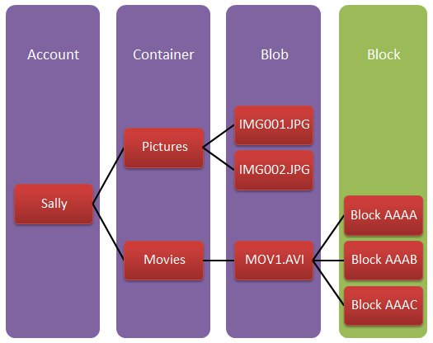
Diagram of BLOB Storage

Slide 15
Common BLOB Usage Case
Storage Service Account: “Song Manager Cloud Program”
Blob Container: “Mike’s Songs”
Blob 1
Metadata
Title=“Layla”
Artist=“Clapton”
Data
Block 1
Block 2

Slide 16
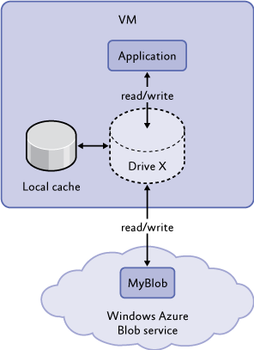
Uncommon but Interesting BLOB case: the BLOB Drive
A disk drive is mapped onto a blob, thereby allowing legacy apps that use file system disk drives to migrate to the cloud with less work.
See Windows Azure Platform SDK and Training Kit, Exploring Windows Azure Storage lab, See the storage Demos

Slide 17
Non-Relational Storage: Tables
These are schema-less collections of name-value pairs. You can use them in any convenient way, like a property bag.
Having said that, you will probably find them most useful in the classic row-column case.
Primary difference from relational tables is the absence of automatic maintenance of relations, for example, no joins are available. But they scale much better than relational tables.

Slide 18
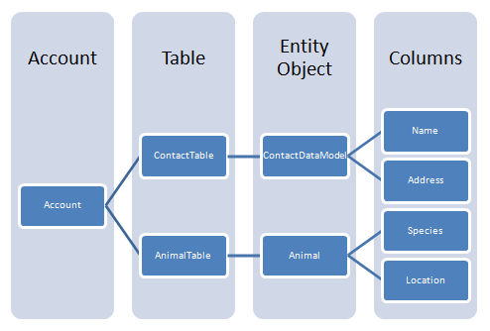
Diagram of Table Storage

Slide 19
Common Table Usage Case
Storage Service Account: “Health Cloud Data Service”
Table “Mike’s Blood Pressure”
Date/Time | Systolic | Diastolic | Pulse
Table “Mike’s Glucose
Date/Time | Glucose Reading mmol/l

Slide 20
Non-relational Storage: Queues
A queue is a classic first-in, first-out data storage structure
Primarily used for passing data from one computing job to another in a loosely-coupled fashion
Generally not used for long-term storage
Scale really well

Slide 21
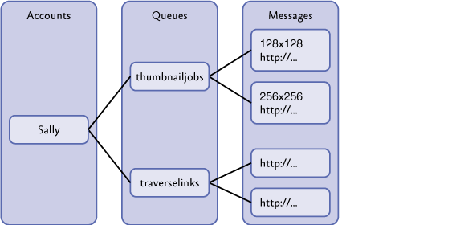
Diagram of Queue Storage

Slide 22
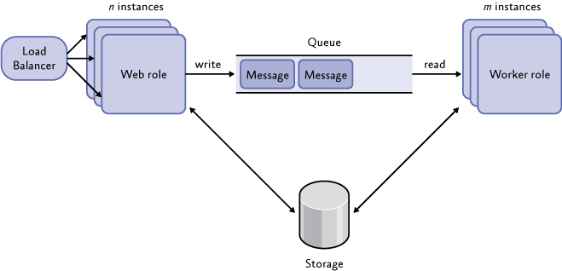
Common Queue Usage Case

Slide 23
Relational Storage 1
This is the familiar database, such as Oracle or MS SQL Server. Made up of tables containing typed columns (schema) and rows (data)
Used when relationships between tables are necessary and complex. For example, an order (row in table of orders) contains a reference to a product (row in table of products) and a customer (row in a table of customers). The customer contains a reference to an address table and payment source table, etc.
Database system itself enforces data integrity, for example, you can’t delete a customer when an order refers to it.

Slide 24
Relational Storage 2
Have historically been the bottleneck of large systems
Scale well on a single node, often a large fast one, but have more trouble scaling out (e.g. cloud), because of need for consistency
Having said that, most legacy data is in this type of storage, so you won’t lose them any time soon.

Slide 25
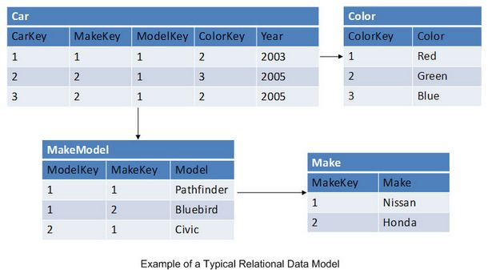
Common Relational Usage Case

Slide 26
Storage Offerings of
Various Cloud Vendors

Slide 27
Amazon’s Storage Offerings
Non-Relational
Simple Storage Service, a blob service
SimpleDB, a table service
Simple Queue service
Relational
Relational Database Service

Slide 28
Google’s Storage Offerings
Non-relational
Blobstore, a blob service
Datastore, a table service
Memcache, an in-memory caching service to speed up performance
Relational
Not currently available, but I bet it comes soon

Slide 29
Azure’s Storage Offerings
Non-relational
Azure Storage Service (bad acronym) provides blobs, tables, and queues as part of basic account.
Relational
SQL Azure is a separate purchase. Basically puts MS SQL Server in the cloud environment. Main snag: currently limited to 50 GB, not huge by current DB standards.

Slide 30
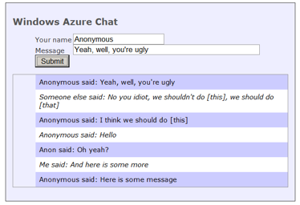
Azure Demonstration:
Cloud Table Storage

Slide 31
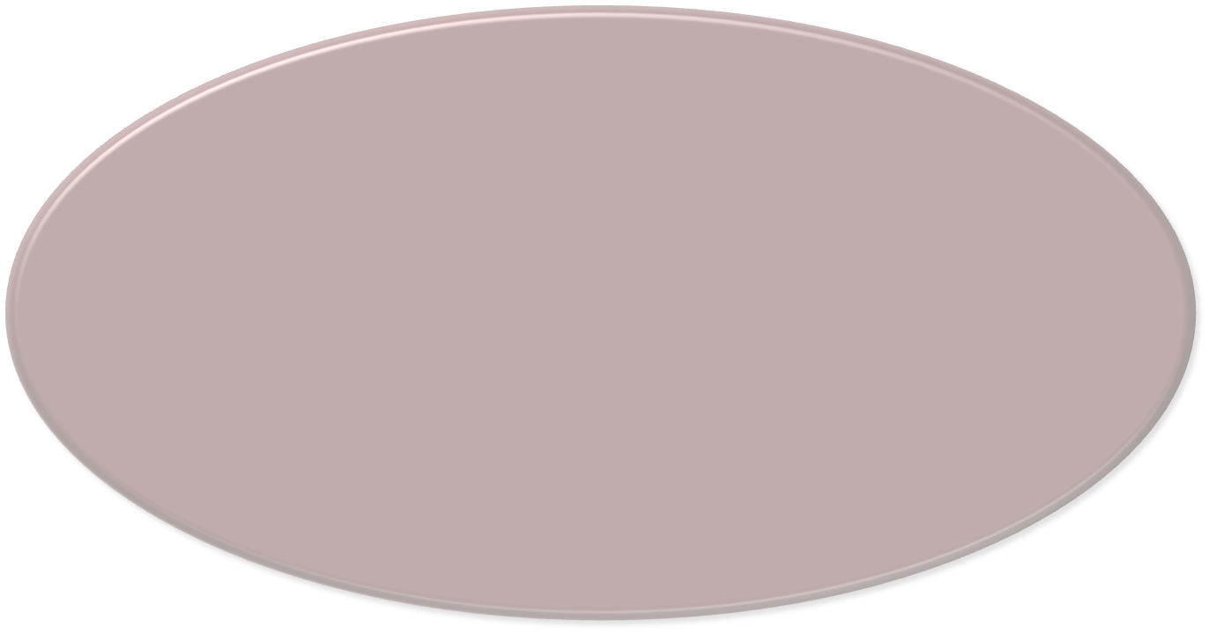

























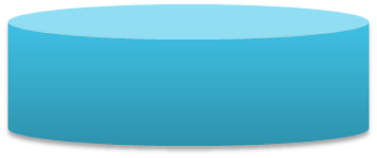







Windows Azure Storage: A closer look at tables
Table
Table
Table
. . .
Entity
Entity
Entity
. . .
Storage Accounts
Property
Property
Property
Name
Type
Value

Slide 32
Windows Azure Storage: Tables: Challenges
Access via REST
  You can’t use ordinary ADO.NET
No SQL
  A new approach for developers to learn
  No aggregates
An unfamiliar structure for data
  You can’t easily move relational data to or from it
  Supporting services are scarce, e.g., reporting
No schema
  And no views

Slide 33
Windows Azure Storage: Tables: Strengths
Massive scalability
  By effectively allowing scale-out data
Perspective:
  Applied to the right problem, Azure Tables are a beautiful thing
    But not optimal for a majority of data storage scenarios
Amazon, Google, and others provide similar storage mechanisms
  It appears to be the state of the art for scale-out data

Slide 34




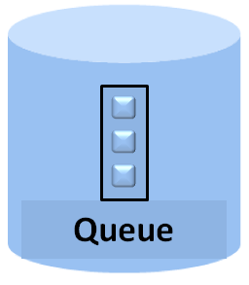
Using Queues: The Suggested Application Model
To scale, add more of either
1) Receive work
Web Role
Worker Role
main()
{ … }
4) Do work
ASP.NET, WCF, etc.
2) Put work in queue
3) Get work from queue

